Slide 1

BC2410, Prescriptive Analytics From Data to Decisions
A Brief Review of Lecture 6

Slide 2
Assignment 2
Question 1: Ax <= b
Question 2:
Two ways of interpretation
In = out
Surplus
Question 3
In = out
Switching cost
Total cost

Slide 3
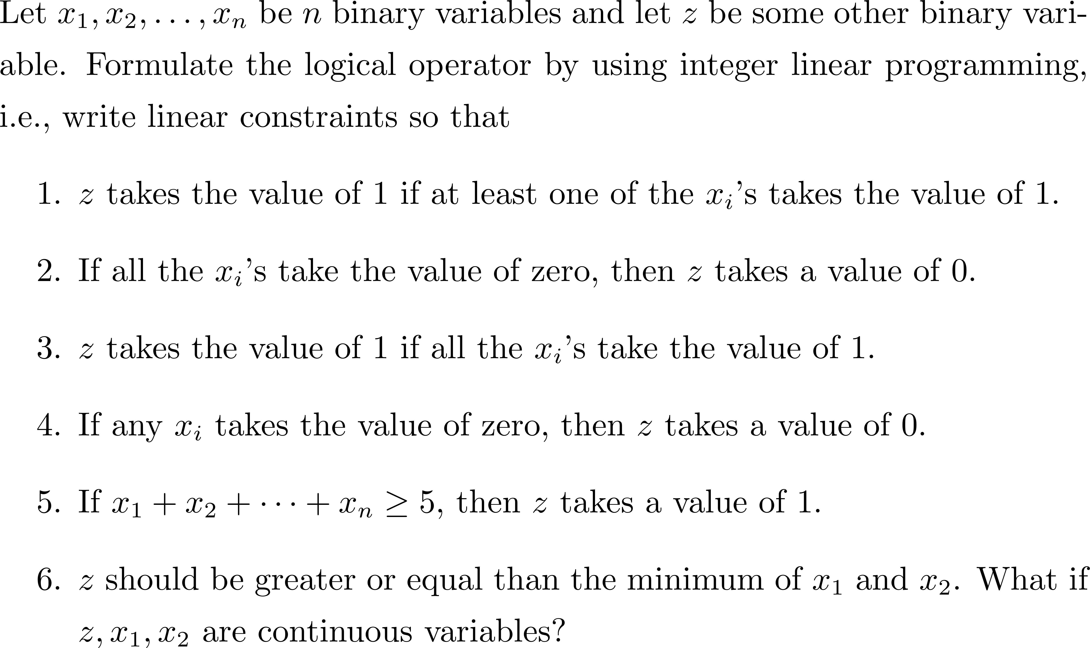
Formulation of Some Conditions

Slide 4
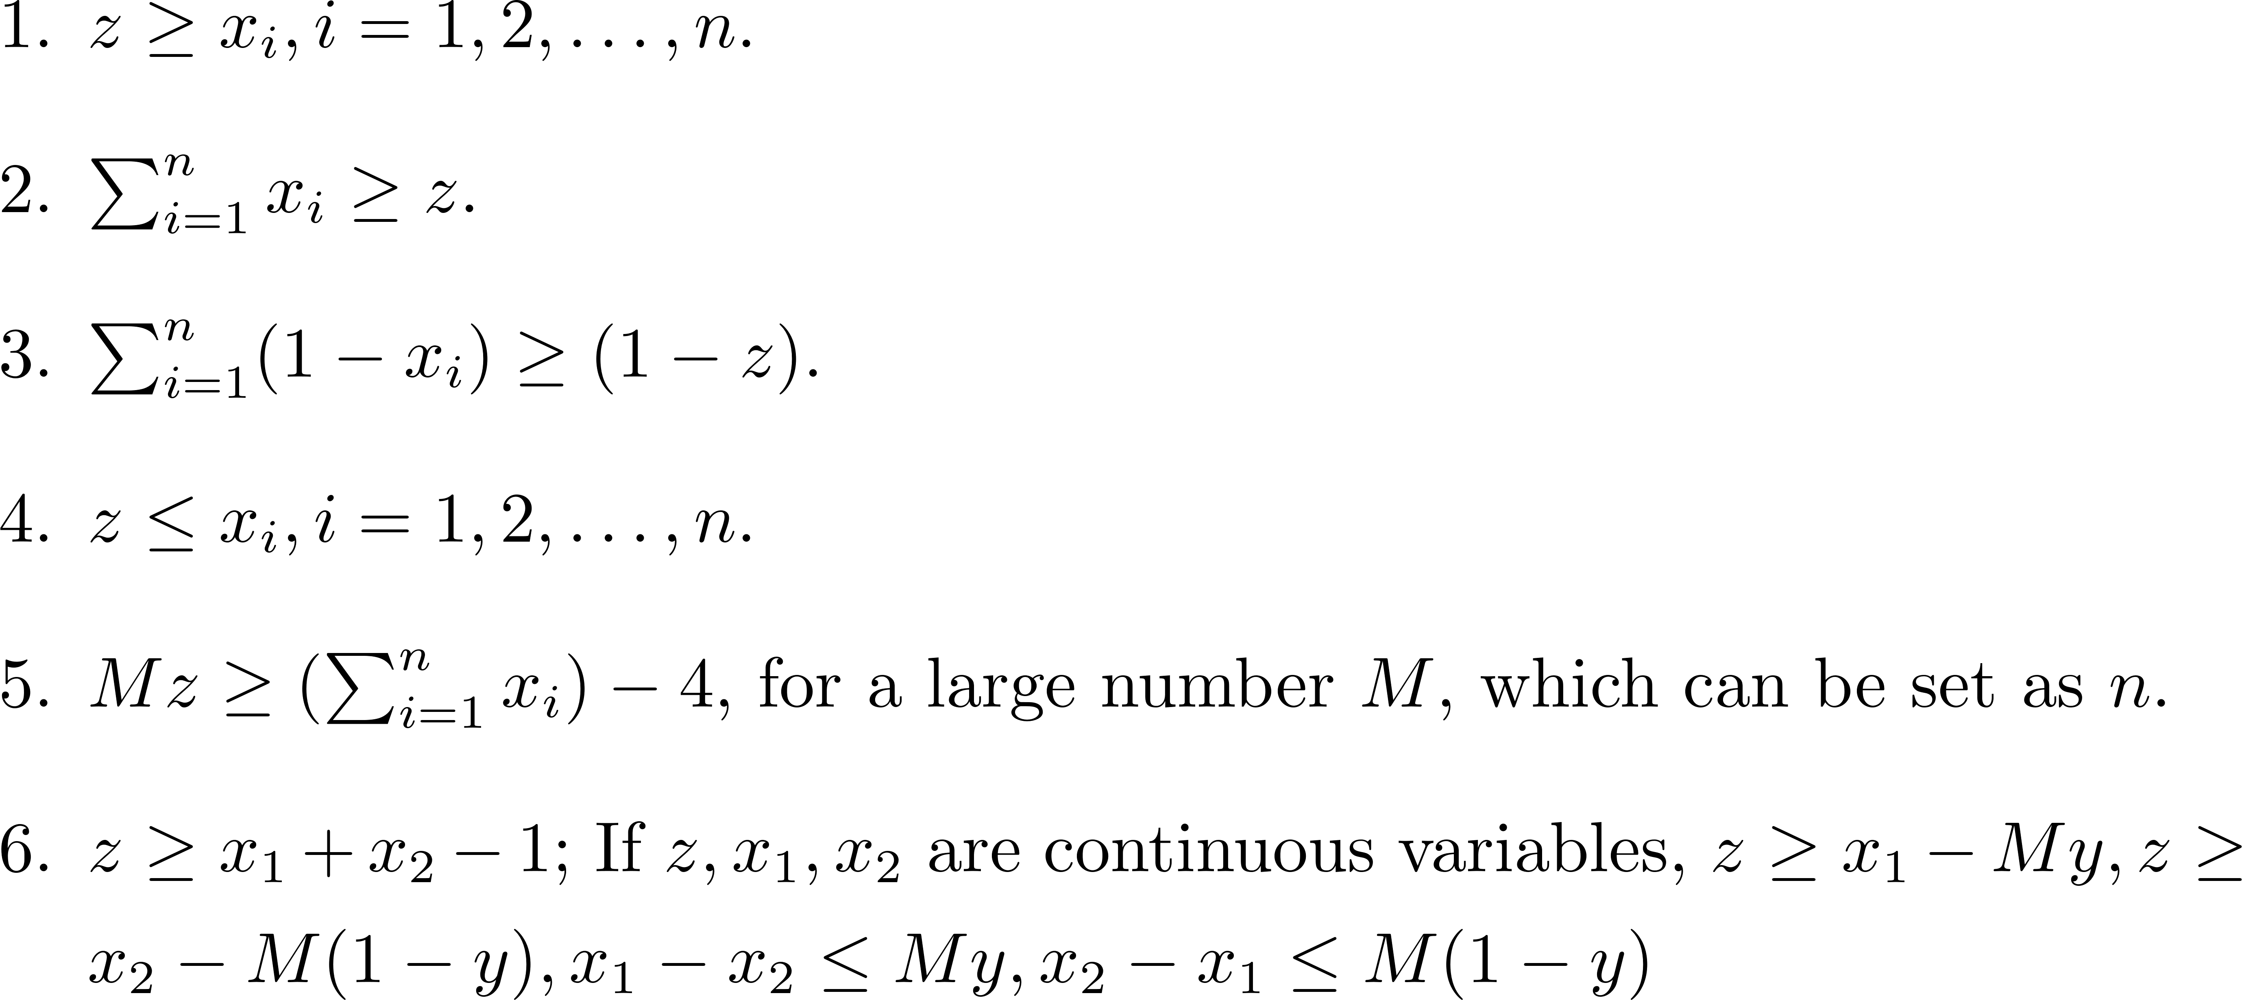
Formulation of Some Conditions

Slide 5
Selection of the Quarantine Hotels
Select at most B hotels for quarantine from a list of m potential hotels, denoted as H = {1,2, … , m}
n districts in a country labelled as N = {1,2,…,n}
I_{i}: predicted number of travellers that need to be quarantined in district i
c_{ij}: transportation cost of allocating a traveller from district i to selected hotel j
u_{j}: capacity of hotel j
f_{j}: a one-time cost of transforming hotel j into a quarantine hotel
Please formulate a LOP to determine which hotel to choose and how to allocate the travellers.

Slide 6
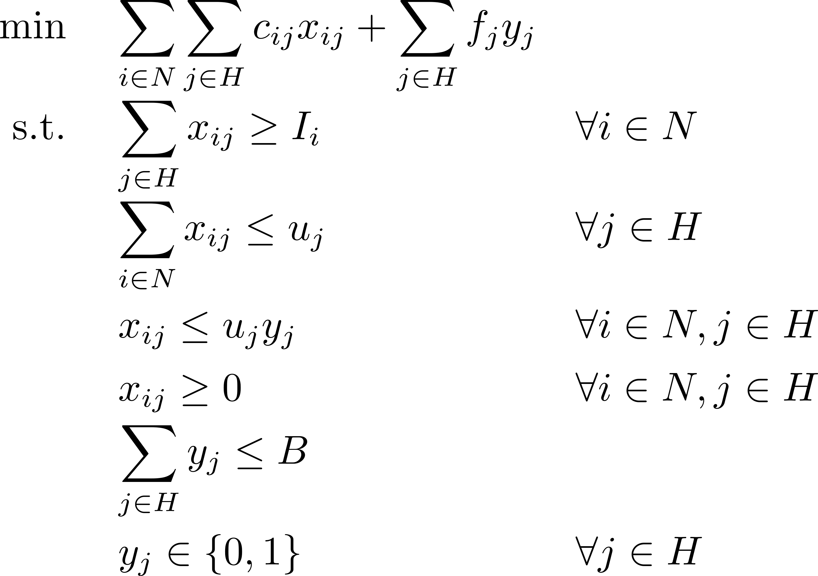

Selection of the Quarantine Hotels

Slide 7

Selection of the Quarantine Hotels
+

Slide 8
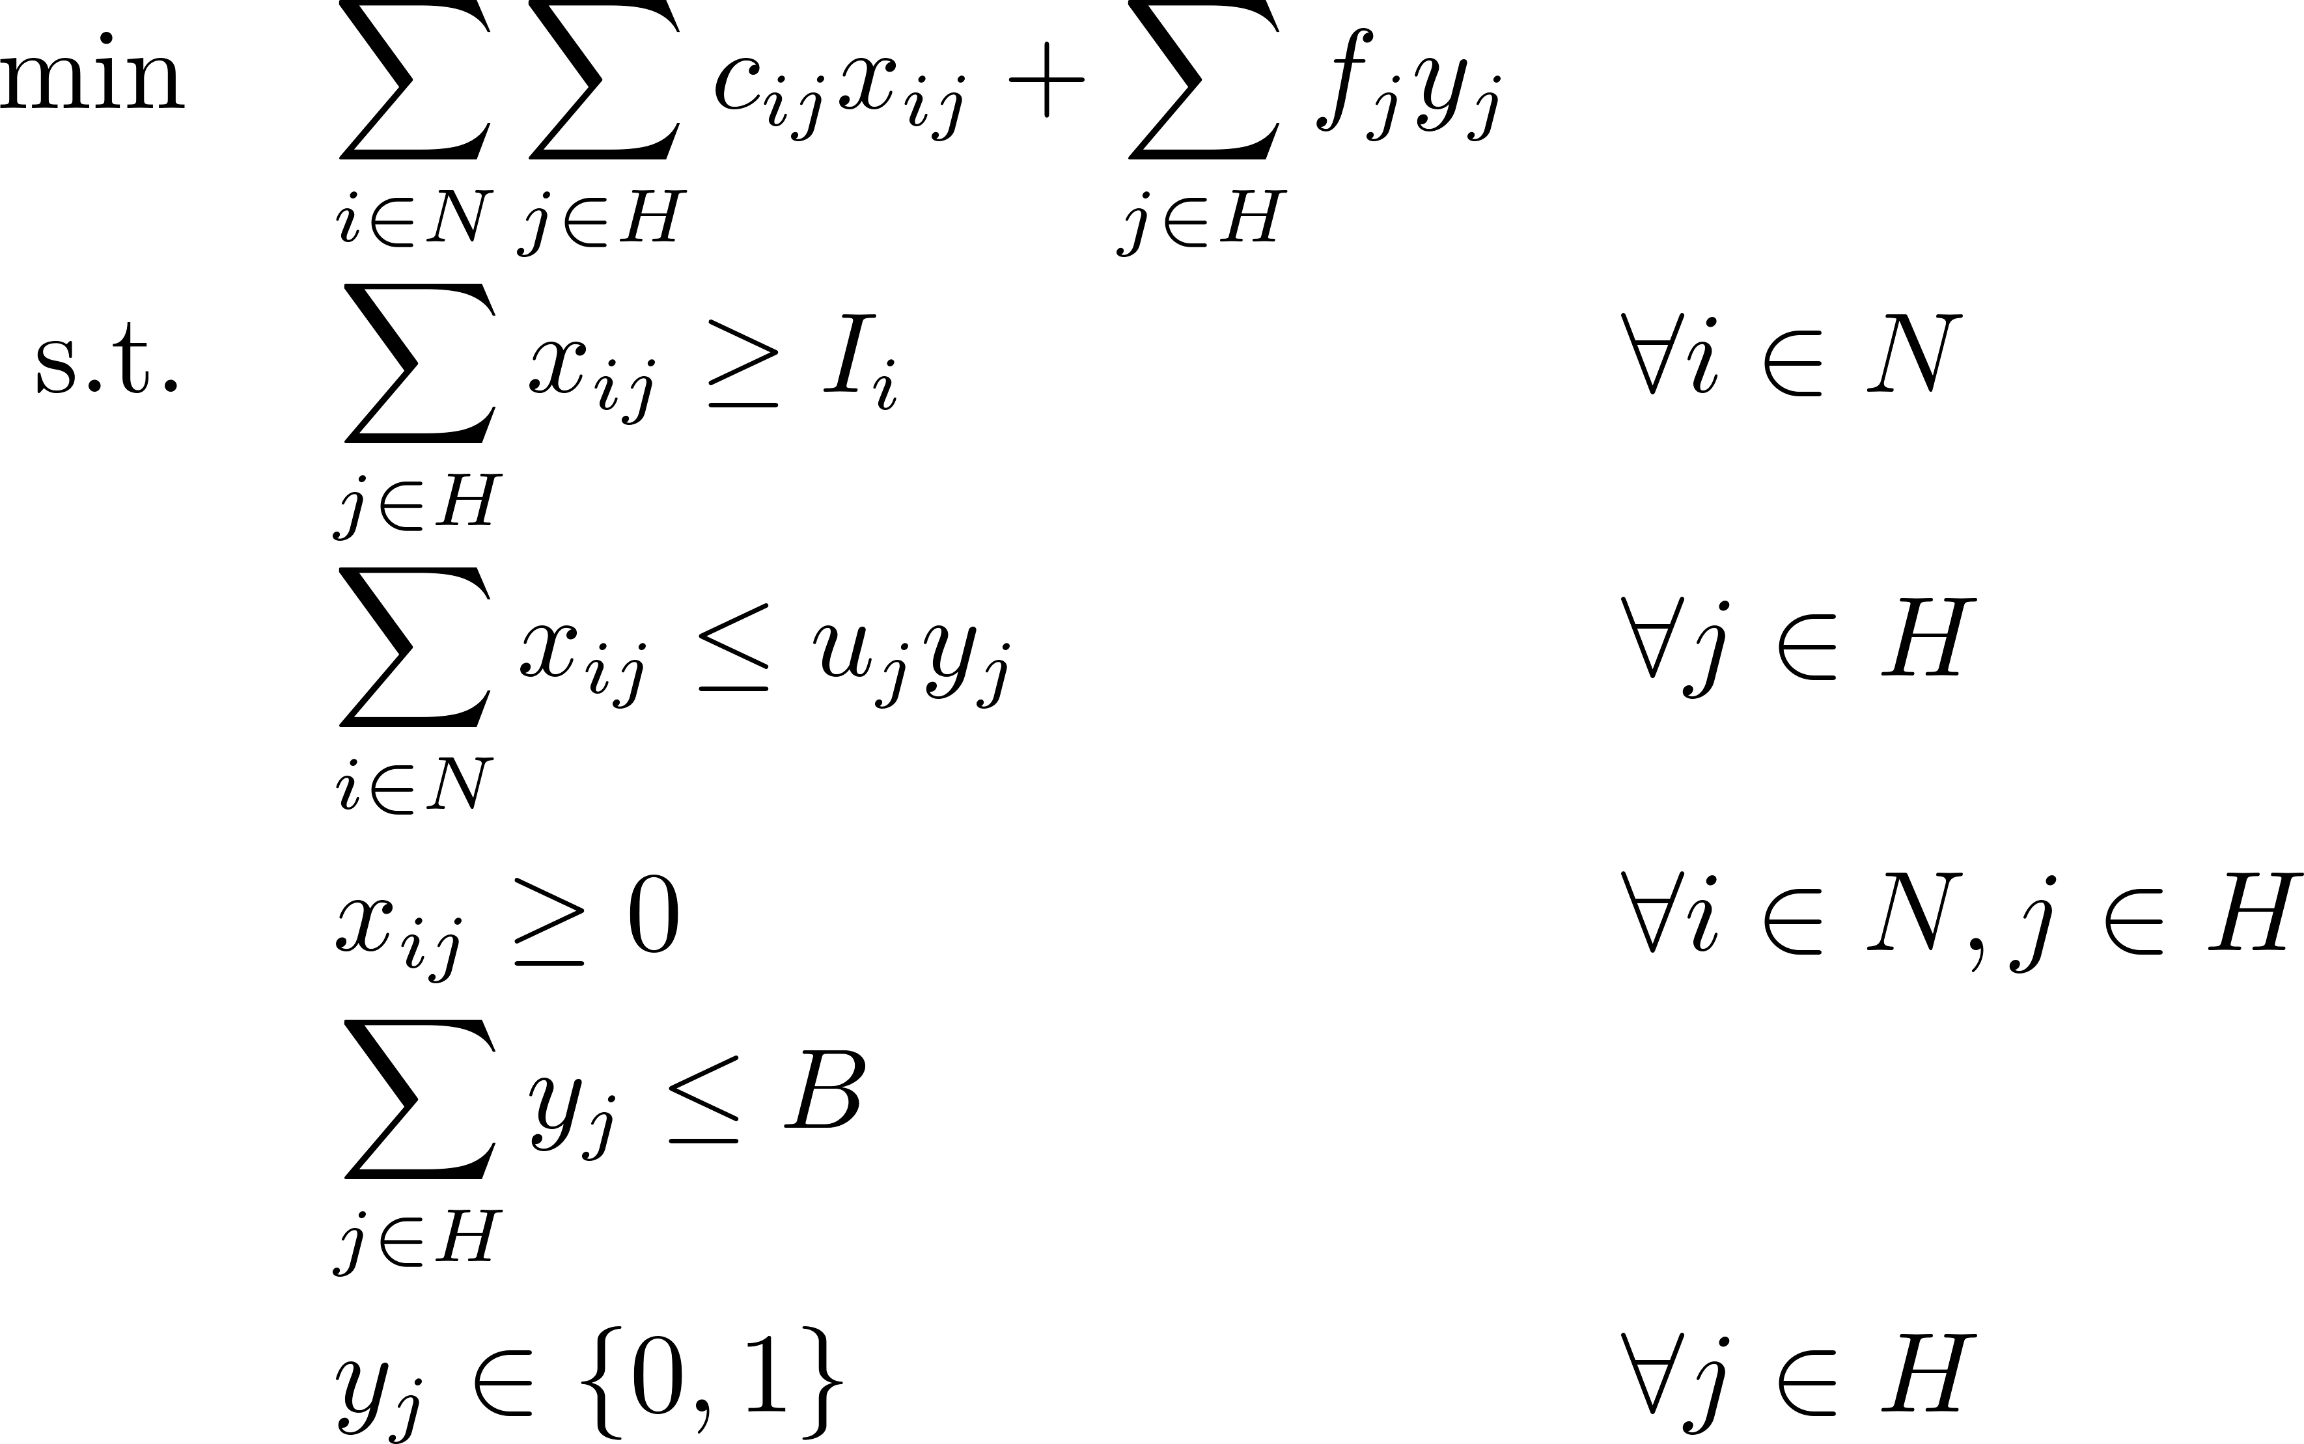
Selection of the Quarantine Hotels

